Slide 1
Elasticity of Demand
Professor Ravi Kiran

Slide 2
Elasticity
Elasticity” is a (standard) measure of the degree of sensitivity (or responsiveness) of one variable to changes in another variable.
The price elasticity of Demand:
The price elasticity of demand is a measure of the degree of sensitivity of demand to changes in the price, ceteris paribus.

Slide 3
Price elasticity of Demand
Change in Quantity /Quantity
Ep = Change in Price/Price
The elasticity measure is a ratio between two percentage measures: the percentage change in one variable over the percentage change in another variable
A price elasticity of -6.25 means that for each one percent change in price the quantity demanded will change by 6.25 percent.

Slide 4
Elasticity of Demand
When the price elasticity of a good is high, we say that the good has “elastic” demand, which means that its quantity demanded responds greatly to price changes.
When the price elasticity of a good is low, it is “inelastic” and its quantity demanded responds little to price changes
Goods that have ready substitutes tend to have more elastic demand than those that have no substitutes.
If all food prices were to rise 20 percent tomorrow, you would hardly expect people to stop eating, so food demands are price-inelastic

Slide 5
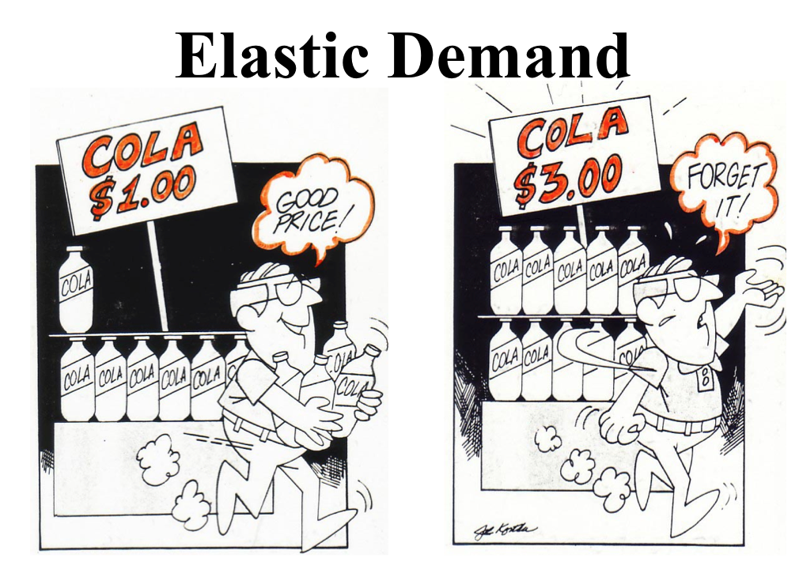

Slide 6
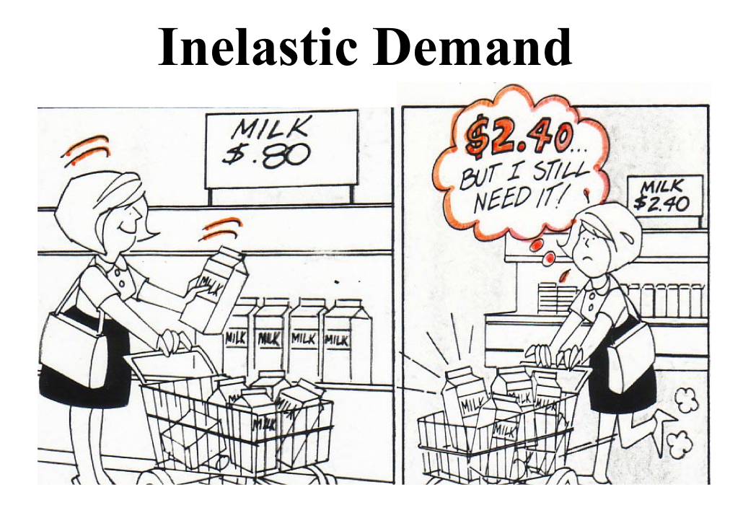

Slide 7
Degrees of elasticity of Demand
Elastic ( > 1). This is where a change in price causes a proportionately larger change in the quantity demanded. In this case the value of elasticity will be greater than 1.
Inelastic ( < 1). This is where a change in a price causes a proportionately smaller change in the quantity demanded.
Unit elastic ( = 1). Unit elasticity of demand occurs where price and quantity demanded change by the same proportion.

Slide 8
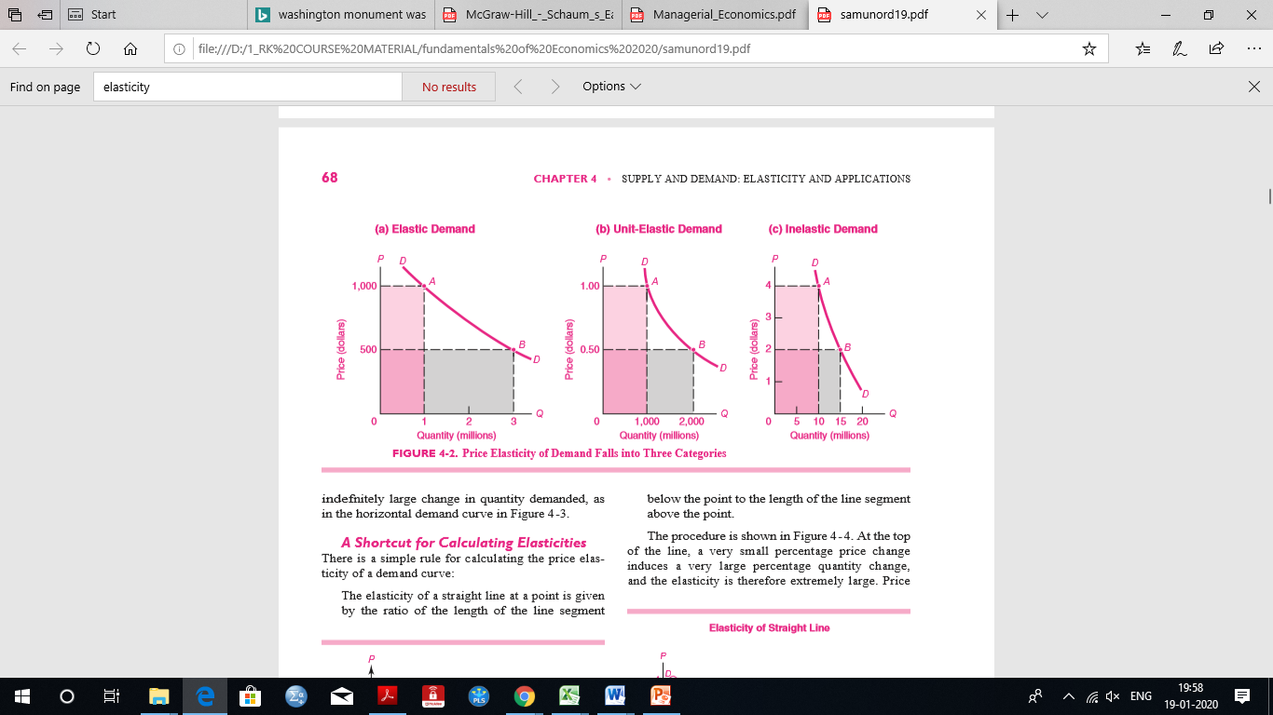

Slide 9
Totally inelastic and elastic demand
Totally inelastic demand : No matter what happens to price, quantity demanded remains the same.
The price rises, the more will be the level of consumer expenditure.
Infinitely elastic demand. This is shown by a horizontal straight line. At any price above P1 demand is zero. But at P1 (or any price below) demand is ‘infinitely’ large.
In this case, the more the individual firm produces, the more revenue will be earned

Slide 10
Totally Elastic and Inelastic demand
D
D
0
Q
0
Q
Infinitely (price) elastic
Infinitely price inelastic

Slide 11
Determinants of price elasticity of demand
The proportion of income spent on the good. The higher the proportion of our income we spend on a good, the more we will be forced to cut consumption when its price rises: the bigger will be the income effect and the more elastic will be the demand.
By contrast, there will be a much bigger income effect when a major item of expenditure rises in price. For example, if mortgage interest rates rise (the ‘price’ of loans for house purchase), people may have to cut down substantially on their demand for housing – being forced to buy somewhere much smaller and cheaper, or to live in rented accommodation.
Will a general item of expenditure like food or clothing have a price-elastic or inelastic demand?

Slide 12
Determinants of price elasticity of demand
Salt has a very low price elasticity of demand Part of the reason is that there is no close substitute.
But part is that we spend such a tiny fraction of our income on salt that we would find little difficulty in paying a relatively large percentage increase in its price: the income effect of a price rise would be very small.

Slide 13
Determinants of price elasticity of demand
The time period. When price rises, people may take a time to adjust their consumption patterns and find alternatives. The longer the time period after a price change, then, the more elastic is the demand likely to be.
Between December 1973 and June 1974 the price of crude oil quadrupled, which led to similar increases in the prices of petrol and central-heating oil. Over the next few months, there was only a very small reduction in the consumption of oil products. Demand was highly inelastic. The reason was that people still wanted to drive their cars and heat their houses.

Slide 14
Determinants of price elasticity of demand
Over time, however, as the higher oil prices persisted, new fuel-efficient cars were developed and many people switched to smaller cars or moved closer to their work.
Similarly, people switched to gas or solid fuel central heating, and spent more money insulating their houses to save on fuel bills.
Demand was thus much more elastic in the long run

Slide 15
Determinants of price elasticity of demand
Luxury or Necessity –Necessity goods have a less elastic( or maybe perfectly inelastic) demand whereas comforts and luxuries have a more elastic demand.
  Restaurants
  Groceries
Habits- If a person is addicted or habituated to a commodity, its demand is inelastic.
addictive drugs

Slide 16
Determinants of price elasticity of demand
The number of close substitutes – the more close substitutes there are in the market, the more elastic is demand because consumers find it easy to switch
The cost of switching between products – there may be costs involved in switching. In this case, demand tends to be inelastic. For example, mobile phone service providers may insist on a12 month contract.

Slide 17
Determinants of price elasticity of demand
Peak and off-peak demand - demand is price inelastic at peak times and more elastic at off-peak times – this is particularly the case for transport services.
Possibility of Postponement: If demand for a product can be postponed it will be elastic.

Slide 18
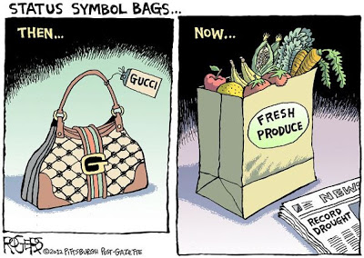
Gucci bag vs Grocery bag---Econ Concepts galore, if you just look for them...
This cartoon (HT: Mike Fladlein) is making a comparison between a Gucci handbag and a bag of groceries. The headline from the newspaper shown in the right panel is "Record Drought".
What is the cartoonist suggesting is the relationship between the drought and the two distinctly different ads?
What economic concepts have you learned about in class can you see in this cartoon? Also, what can you say about the price elasticity of demand (PED) for each of these "goods"? Relatively elastic? Inelastic? Unit elastic?
Source: Mike Fladlein at Mikeroconomics

Slide 19
Demand Measurement : Total revenue method
One of the most important applications of price elasticity of demand concerns its relationship with the total amount of money consumers spend on a product.
Total consumer expenditure (TE) is simply price times quantity purchased.
TE = P × Q

Slide 20
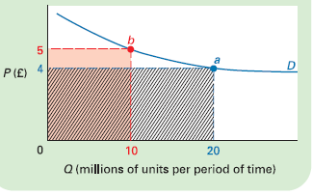
Elastic demand between two points

Slide 21
Elastic demand
As price rises so quantity demanded falls, and vice versa. When demand is elastic, quantity demanded changes proportionately more than price.
Thus the change in quantity has a bigger effect on total consumer expenditure than does the change in price. For example, when the price rises, there will be such a large fall in consumer demand that less will be spent than before.
This can be summarized as follows:
• P rises; Q falls proportionately more; thus TE falls.
• P falls; Q rises proportionately more; thus TE rises.
In other words, total expenditure changes in the same direction as quantity.

Slide 22
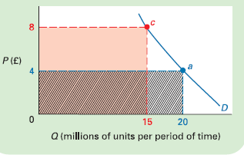
Inelastic demand between two points

Slide 23
Inelastic demand
When demand is inelastic, it is the other way around.
Price changes proportionately more than quantity. Thus the
change in price has a bigger effect on total consumer expenditure than does the change in quantity.
To summarise the effects:
• P rises; Q falls proportionately less; TE rises.
• P falls; Q rises proportionately less; TE falls.
In other words, total consumer expenditure changes in the same direction as price.
In this case, firms’ revenue will increase if there is a rise
in price and fall if there is a fall in price.

Slide 24
Total revenue method
One of the most important applications of price elasticity of demand concerns its relationship with the total amount of money consumers spend on a product.
Total consumer expenditure (TE) is simply price times quantity purchased.
TE = P × Q

Slide 25
Elastic demand between two points

Slide 26
Elastic demand
As price rises so quantity demanded falls, and vice versa. When demand is elastic, quantity demanded changes proportionately more than price.
Thus the change in quantity has a bigger effect on total consumer expenditure than does the change in price. For example, when the price rises, there will be such a large fall in consumer demand that less will be spent than before.
This can be summarized as follows:
• P rises; Q falls proportionately more; thus TE falls.
• P falls; Q rises proportionately more; thus TE rises.
In other words, total expenditure changes in the same direction as quantity.

Slide 27
Inelastic demand between two points

Slide 28
Inelastic demand
When demand is inelastic, it is the other way around.
Price changes proportionately more than quantity. Thus the
change in price has a bigger effect on total consumer expenditure than does the change in quantity.
To summarise the effects:
• P rises; Q falls proportionately less; TE rises.
• P falls; Q rises proportionately less; TE falls.
In other words, total consumer expenditure changes in the same direction as price.
In this case, firms’ revenue will increase if there is a rise
in price and fall if there is a fall in price.

Slide 29
Elasticity of demand
When demand is inelastic, total revenue is more influenced by the higher price and increases as price increases. When demand is elastic, total revenue is more influenced by the lower quantity and decreases as price increases.

Slide 30
Arc (Price) Elasticity
Note that if we increased the price,
(from 8 to 10 or 2 to 4)
the original P and Q would be 2 and 8 and 18 and 90, respectively.
Ep = (-10/18)/(2/8) = -2.22
Ep = (-10/90)/(2/2) = -.11
P
a
10
b
8
c
4
d
2
D
8
18
80
90
Q

Slide 31
Arc Elasticity
To get the average elasticity between two points on a demand curve we take the average of the two end points (for both price and quantity) and use it as the initial value:
Q2-Q1 10
(Q1+Q2)/2 ( 8+18)/2
Ed =
P2-P1 -2
(P1+P2)/2 (10+8)/2
= 10/13 = (-)3.46
-2/9

Slide 32
Point Elasticity of demand
Since we want to measure price elasticity at a point on the demand curve, rather than between two points, it is necessary to know how quantity demanded would react to an infinitesimally small change in price.
For an infinitesimally small change the formula for price elasticity of demand thus becomes:
  dQ×P
  dP Q
dQ/dP is the differential calculus term for the rate of change of quantity with respect to a change in price

Slide 33
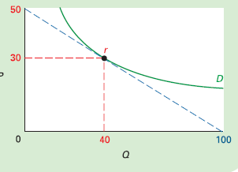
Measuring elasticity at a point

Slide 34
Measuring elasticity at a point
dP/dQ is the rate of change of price with respect to a change in quantity demanded.
At any given point on the demand curve, dP/dQ is given by the slope of the curve (its rate of change).
The slope is found by drawing a tangent to the curve at that point and finding the slope of the tangent.
The tangent to the demand curve at point r is shown in Figure
Its slope is −50/100. dP/dQ is thus −50/100 and
dQ/dP is the inverse of this, −100/50 = −2.
ED= dQ/dP × P/Q,
−2 × 30/40 = −1.5

Slide 35
Price elasticity of demand
PD = dQ /dP × P/Q
The term dQ/dP can be calculated by differentiating the demand equation:
Given Qd = 60 − 15P + P²
then dQ/dP = −15 + 2P
Thus at a price of 3, for example,
dQ/dP = −15 + (2 × 3)
= −9
Thus price elasticity of demand at a price of 3
= −9 × P/Q
= −9 × 3/24
= −9/8 (which is elastic)

Slide 36
Selected price elasticities
Cigarettes -0.3 to -0.6 US population
-newspaper -0.1
Oil -0.4 World
Rice -0.47Austria-0.8 Bangladesh-0.8 China-0.25 Japan-0.55 US
Beef- -1.6 US
Legal gambling -1.9 US-0.80 to -1.0 Indiana
Movies -0.87 US-0.2 Teenagers US2.0 Adults
2.8Coke
3.8[Mountain Dew

Slide 37
Elasticity Along a Demand Curve
E_{d} = ∞
$10
Elasticity declines along demand curve as we move toward the quantity axis
9
8
E_{d} > 1
7
6
Price
E_{d} = 1
5
4
3
E_{d} < 1
2
1
E_{d} = 0
0
1
2
3
4
5
6
7
8
9
10
Quantity

Slide 38
Is the price elasticity of demand for chocolate ice cream is greater than the price elasticity of demand for ice cream
The price elasticity of demand for chocolate ice cream is greater than the price elasticity of demand for ice cream in general.
There are more substitutes for chocolate ice cream than for ice cream in general.
Substitution will be “easier” due to the similarities across different flavors of ice cream.
This makes the price elasticity of demand for chocolate ice cream greater than that for ice cream in general.

Slide 39
Question?
Why will the price elasticity of demand for a particular brand of a product (e.g. Amul) greater than that for the product in general (e.g. Ice cream)?

Slide 40
Price elasticity price elasticity of demand for a particular brand of a product (e.g. Amul) is greater than that for the product in general (e.g. Ice cream)?
The price elasticity of demand for a particular brand is more elastic than that for a product in general because people can switch to an alternative brand if the price of one brand goes up.
No such switching will take place if the price of the product in general (i.e. all brands) goes up.
Thus the difference in elasticity is the result of a difference in the size of the substitution effect.

Slide 41
Income Elasticity of Demand:
  The responsiveness of demand to changes in incomes
Normal Good – demand rises as income rises and vice versa
Inferior Good – demand falls as income rises and vice versa

Slide 42
Cross Elasticity:
The responsiveness of demand of one good to changes in the price of a related good – either a substitute or a complement
%Change in Demand for X Commodity
% Change in price of Y Commodity

Slide 43
Cross Elasticity
Goods which are complements:
  Cross Elasticity will have negative sign (inverse relationship between the two)
Goods which are substitutes:
  Cross Elasticity will have a positive sign (positive relationship between the two)

Slide 44
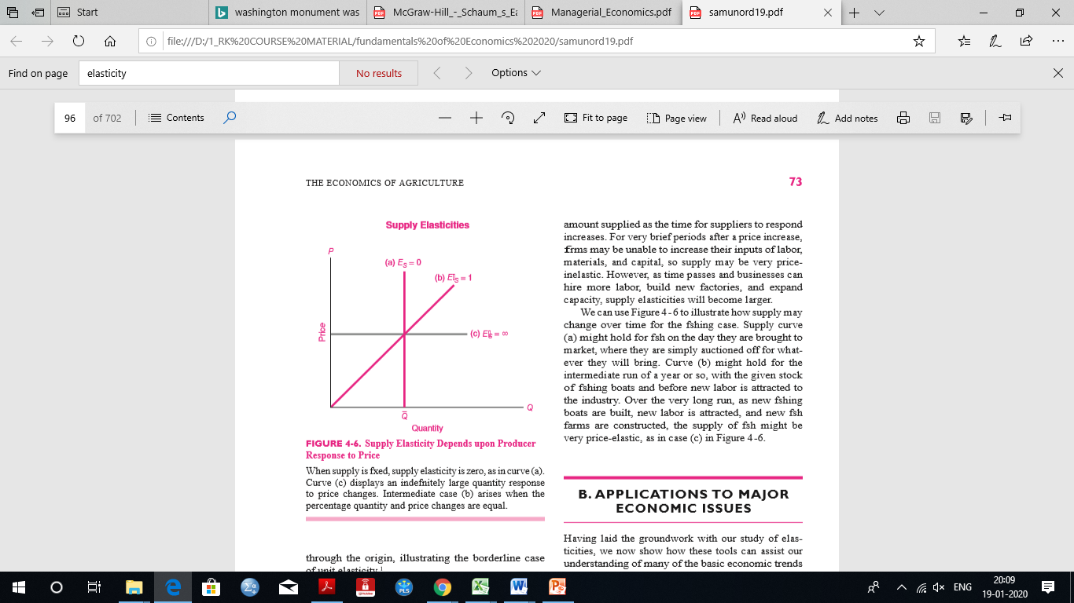
Price elasticity of supply is the percentage change in quantity supplied divided by the percentage change in price

Slide 45
What factors determine supply elasticity?
The major factor influencing supply elasticity is the ease with which production in the industry can be increased.
If all inputs can be readily found at going market prices, as is the case for the textile industry, then output can be greatly increased with little increase in price. This would indicate that supply elasticity is relatively large.

Slide 46
What factors determine supply elasticity?
On the other hand, if production capacity is severely limited, as is the case for gold mining, then even sharp increases in the price of gold will call forth but a small response in gold production; this would be inelastic supply.
Another important factor in supply elasticities is the time period under consideration. A given change in price tends to have a larger effect on amount supplied as the time for suppliers to respond increases. For very brief periods after a price increase, firms may be unable to increase their inputs of labor, materials, and capital, so supply may be very price- inelastic.

Slide 47

1 When supply falls, what happens to quantity demanded in equilibrium? *
a. Quantity demanded increases
b. Quantity demanded decreases
c. A change in supply has no effect on quantity demanded
2 If oil executives read in the newspaper that massive new oil supplies have been discovered under the Pacific Ocean but will likely only be useful in 10 years, what is likely to happen to the supply of oil today? *
a. The supply of oil will rise today
b. The supply of oil will fall today
c. There will be no change in the supply of oil

Slide 48
If oil executives read in the newspaper that new solar-power technologies have been discovered but will likely only become useful in 10 years, what is the likely equilibrium impact on the price and quantity of oil today? *
a. the price of oil will increase, the quantity of oil will decrease
b. the price of oil will decrease, the quantity of oil will increase
c. the price and quantity of oil will decrease
d. the price and quantity of oil will increase
If we learn today about promising future energy sources, today’s price of energy will _______ and today’s quantity of energy will __________. *
a. rise, fall
b. fall, rise
c. rise, rise
d. fall, fall

Slide 49
1 When supply falls, what happens to quantity demanded in equilibrium? *
a. Quantity demanded increases
b. Quantity demanded decreases
c. A change in supply has no effect on quantity demanded
2 If oil executives read in the newspaper that massive new oil supplies have been discovered under the Pacific Ocean but will likely only be useful in 10 years, what is likely to happen to the supply of oil today? *
a. The supply of oil will rise today
b. The supply of oil will fall today
c. There will be no change in the supply of oil

Slide 50
3. If oil executives read in the newspaper that new solar-power technologies have been discovered but will likely only become useful in 10 years, what is the likely equilibrium impact on the price and quantity of oil today? *
a. the price of oil will increase, the quantity of oil will decrease
b. the price of oil will decrease, the quantity of oil will increase
c. the price and quantity of oil will decrease
d. the price and quantity of oil will increase
4 If we learn today about promising future energy sources, today’s price of energy will _______ and today’s quantity of energy will __________. *
a. rise, fall
b. fall, rise
c. rise, rise
d. fall, fall

Slide 51
P
a
10
b
8
c
4
d
2
D
80
90
Q
8
18
Ep (a --- b) = (10/8)/(-2/10) = -6.25
Ep (c ---d ) = (10/80)/(-2/4) = -.25

Slide 52
Pricing on the buses
Imagine that a local bus company is faced with increased costs and fears that it will make a loss.
What should it do? The most likely response of the company will be to raise its fares. But this may be the wrong policy, especially if existing services are under-utilized.
To help it decide what to do, it commissions a survey to estimate passenger demand at three different fares: the current fare of 10p per mile, a higher fare of 12p and a lower fare of 8p.
The results of the survey are shown in the first two columns of the table.
Demand turns out to be elastic. This is because of the existence of alternative means of transport. As a result of the elastic demand, total revenue can be increased by reducing the fare from the current 10p to 8p. Revenue rises from £400 000 to £480 000 per annum.
But what will happen to the company’s profits? Its profit is the difference between the total revenue from passengers and its total costs of operating the service.

Slide 53
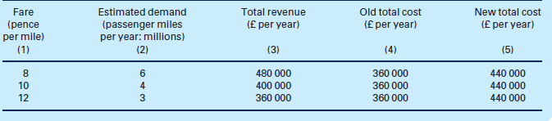
If buses are currently under-utilized, it is likely that the extra passengers can be carried without the need for extra buses, and hence at no extra cost.
At a fare of 10p, the old profit was £40 000 (£400 000 − £360 000). After the increase in costs, a 10p fare now gives a loss of £40 000 (£400 000 – £440 000).
By raising the fare to 12p, the loss is increased to £80 000. But by lowering the fare to 8p, a profit of £40 000 can again be made.
1. Estimate the price elasticity of demand between 8p and 10p and between 10p and 12p.
2. Was the 10p fare the best fare originally?
3. The company considers lowering the fare to 6p, and estimates that demand will be 81/2 million passenger miles. It will have to put on extra buses, however. How should it decide?

Slide 54

Estimate the price elasticity of demand between 8p and 10p and between 10p and 12p.
A) The mid-point formula for price elasticity is Qd/averageQd
P/average P.
Thus between 8p and 10p, price elasticity equals –2/5
2/9
= –9/5 = –1.8(elastic)
Between 10p and 12p,
price elasticity equals
–1/3.5 ÷ 2/11= –11/7 = –1.57(elastic)

Slide 55
B) Was the 10p fare the best fare originally?
No. At a price of 10 p A profit of £400000 – £360000 = £40000 was made.
At a price of 8p, however, a higher profit of £480000 – £360000 = £120000 could have been made.

Slide 56
C) The company considers lowering the fare to 6p, and estimates that demand will be 8 .5 million passenger miles. It will have to put on extra buses, however. How should it decide?
The company considers lowering the fare to 6p, and estimates that demand will be 8.5million passenger miles.
It will have to put on extra buses, however. How should it decide?
If it lowers the price to 6p, the revenue will rise to £510000
(6p *8.5m).
But putting on extra buses will also increase costs. It will only, therefore, be worth lowering the price if the increase in revenue is greater than the increase in costs.

